Slide 1
CS 476 Project: You Are Precious
By: Shawn Fernandes and Harpinder Minhas

Slide 2
Problems
Mental Illness is a very common problem in society today.
Affects everyone at different points in their life.
Manifests in different ways and forms.
Occurs because of different reasons.
Can be taboo to discuss.
Still ongoing work.
Ability to develop a community that helps.

Slide 3
Motivations and Goals
Motivation:
A lot of people are experiencing loneliness and are having suicidal thoughts due to isolation cased by the covid-19 pandemic. Since more people are using technology, we wanted to provide a solution that was available to them online.
Goals:
Develop a website that lets users seek help.
Give more focus to abuse and suicide.
Give people a helpful platform that lets them get advise.
Give people the ability to let users share their issues and stories.

Slide 4
Implemented Functional Requirements.
Users will be able to create a guest account (anonymous) or a verified alias account with Email, or a Phone number.
Users are able to make post anonymously, or with a verified alias account.
Users with a verified alias account are able to like and comment on a post.
Users can submit a get help form which can be used by admins to support the user.
A verified alias account user needs to fill out a form with information that is not personally identifiable.
Users are able to view posts by types, classifications, and tags.
Users with a verified alias account are able to see all that they have posted.

Slide 5
Design Pattern: Model-View-ViewModel (MVVM)
The JavaScript framework, VueJS, was created with the MVVM pattern in mind. Which is why MVVM is a natural design pattern when creating with VueJS.
Model-View-ViewModel (MVVM) is a structural design pattern that separates objects into three distinct groups: Model, View and View-Models
Models: Contain application data.
View: Contains the UI elements and things that the user will interact with
View Models: Transforms data contained in models to be displayed onto the view. It serves as the bridge between model and view.
Vue.js is technically focused on the ViewModel layer of the MVVM pattern. It connects the View and the Model via two way data bindings. Actual DOM manipulation and output formatting are abstracted away into directives and filters.
Notes:
Models: In Vue.js, models are simply plain JavaScript objects, or data objects. Once an object is used as data inside a Vue instance, it becomes reactive. You can manipulate their properties and Vue instances that are observing them will be notified of the changes.
View: Vue.js uses DOM-based templating. Each Vue instance is associated with a corresponding DOM element. When a Vue instance is created, it recursively walks all child nodes of its root element while setting up the necessary data bindings. After the View is compiled, it becomes reactive to data changes.
ViewModel: An object that syncs the Model and the View. In Vue.js, every Vue instance is a ViewModel. They are instantiated with the Vue constructor or its sub-classes.

Slide 6
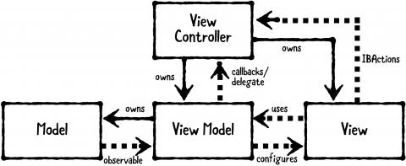
Source: https://koenig-media.raywenderlich.com/uploads/2018/04/MVVM_Diagram-480x197.png
Notes:
This design pattern is best used when we want to transform models into different representation of a view.
This pattern compliments with MVC very well.

Slide 7
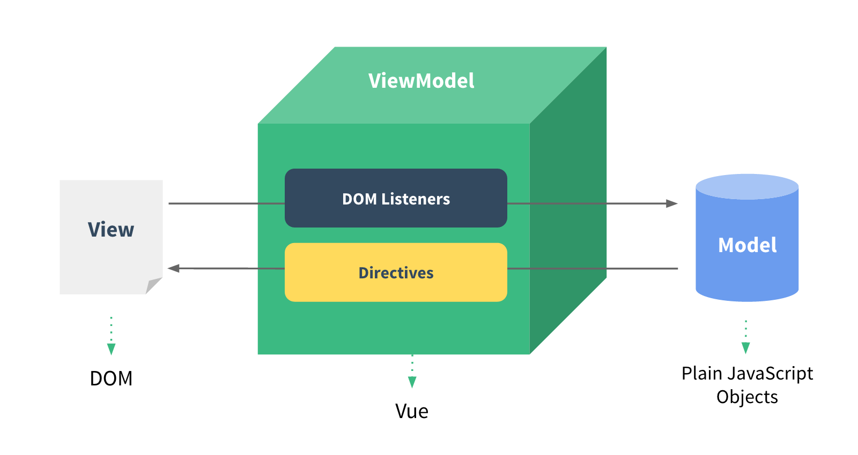
Source: https://012.vuejs.org/images/mvvm.png
Notes:
Showcase where models are transformed in the website. Allposts vs Type specific posts.

Slide 8
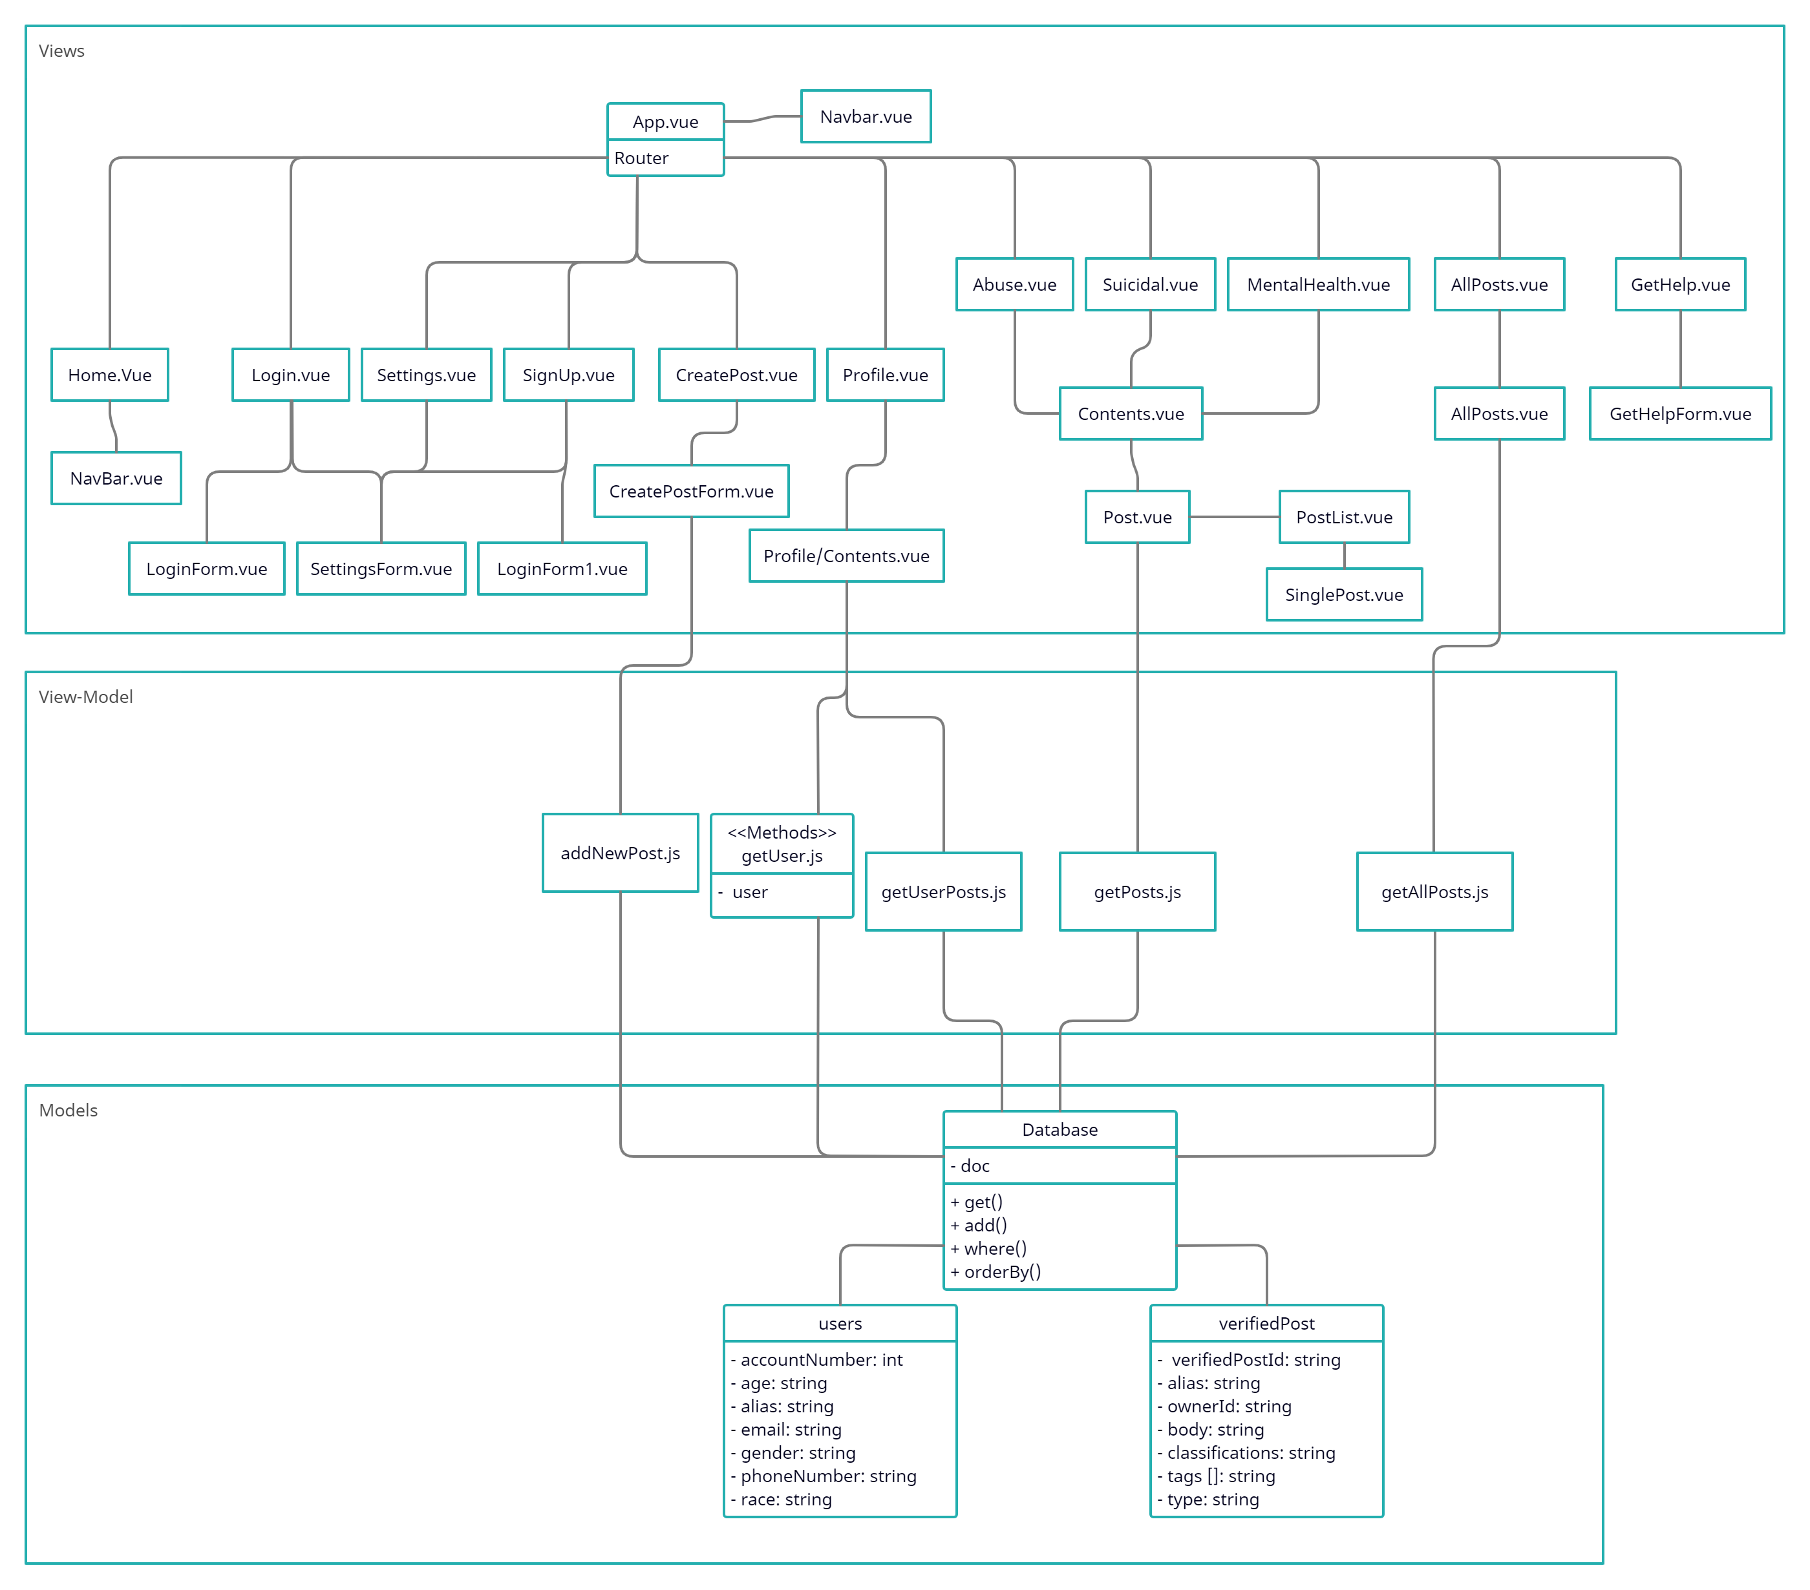

Slide 9
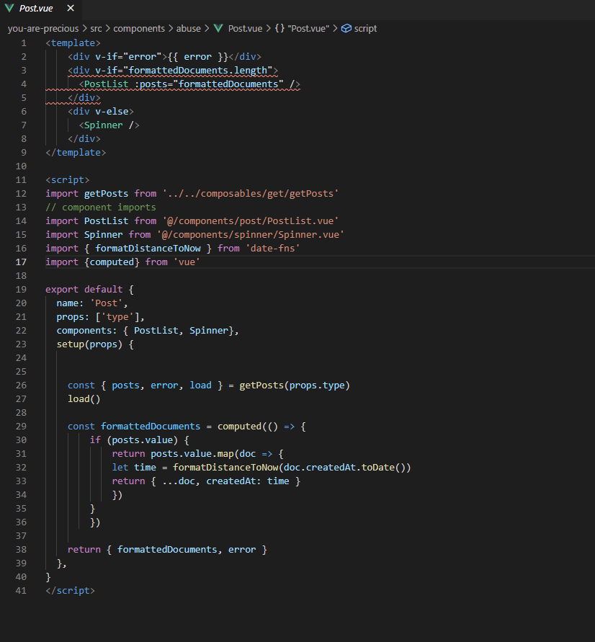

Slide 10
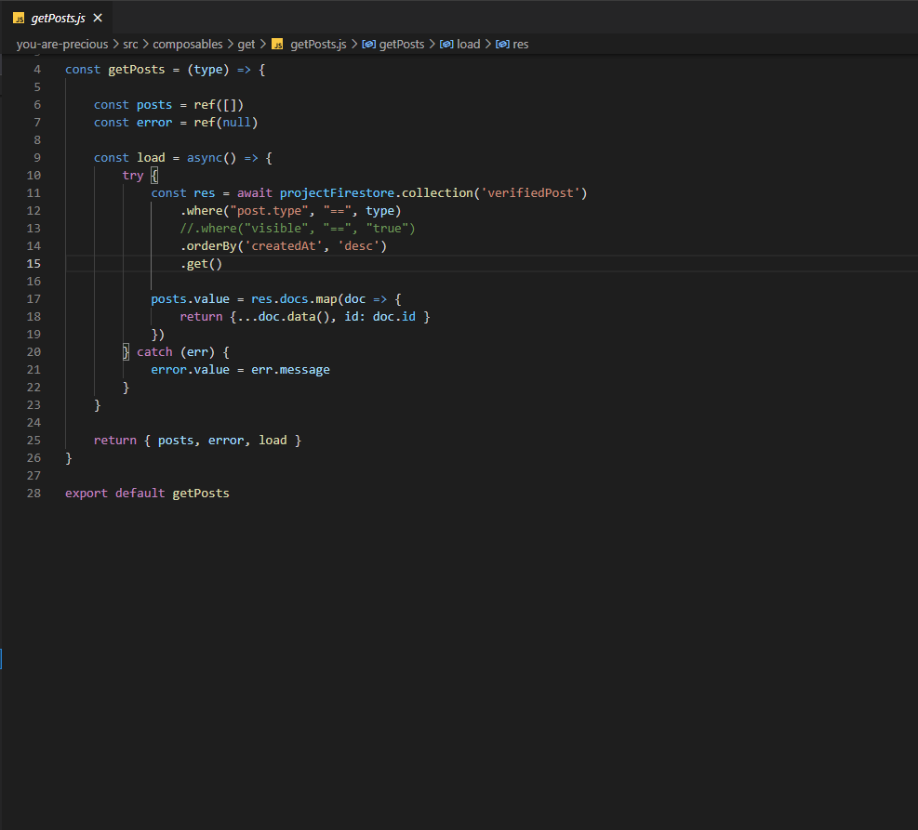

Slide 11
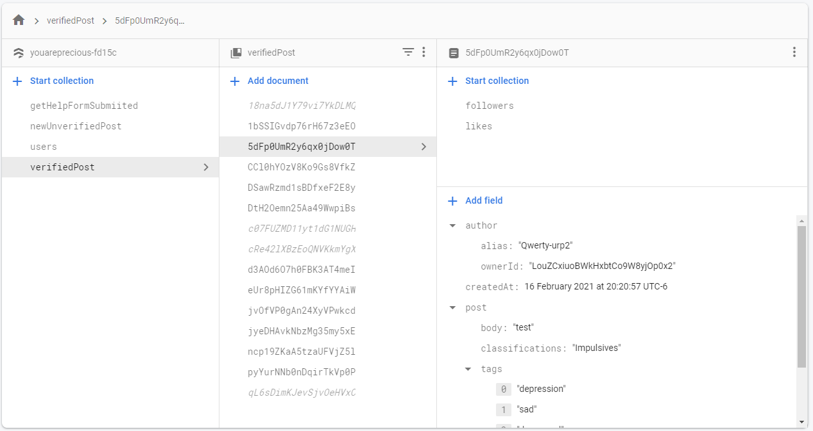

Slide 12
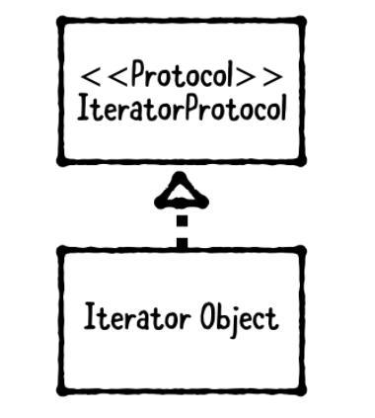
Design Pattern: Iterator
Iterator Pattern: The iterator pattern is a behavioral pattern. It allows the use of an iterator to traverse though any collection in a standard way.
Source: https://www.raywenderlich.com/books/design-patterns-by-tutorials/v3.0/chapters/13-iterator-pattern

Slide 13
Design Pattern: Iterator Pattern
Objective: Print all the posts that belong to a user on the screen.
Database: The Firestore database has many collections. One of the collection is called verifiedPost. The collection verifiedPost contains all the posts that have been posted by verified users. There are multiple documents in the verifiedPost. Each document represents a single post. These documents contain fields which are of different data types such as string, timestamp, boolean as well as collections such as map, array etc.
Problem: Our goal is to print all these posts and display their fields if they have any. Since clearly the posts can have different datatypes or collections such as maps or arrays, we need to find a way to iterate through them uniformly to make the collection iterable for the iterator.

Slide 14
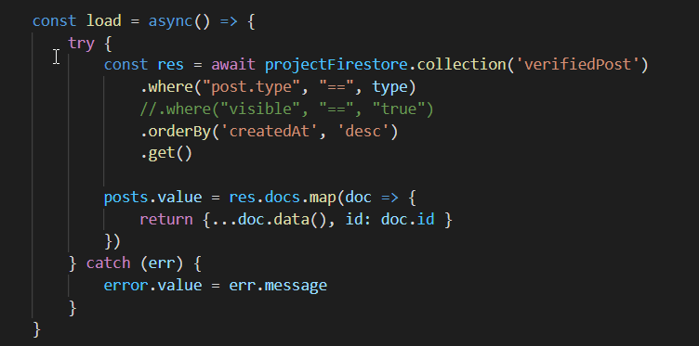
Design Pattern: Iterator Pattern
Aggregate: The purpose is to create a collection of objects that is iterable. The spread syntax(…) and the map method is used to parse the data that has been received from the Firestore Database and to convert it into a collection of objects which can be referenced by the constant posts. This collection of object can be now be iterated by the iterator.

Slide 15
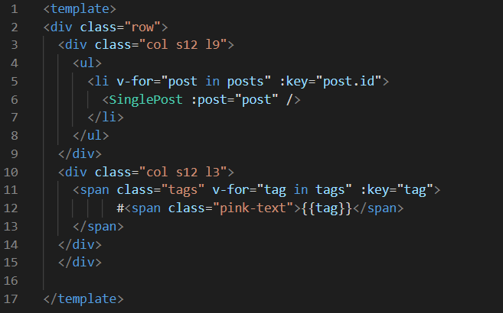
Design Pattern: Iterator Pattern
Iterator: v-for is the iterator that iterates through the collection of posts. It goes through all the posts one at a time. Each post is added to the list that is to be displayed one by one.

Slide 16
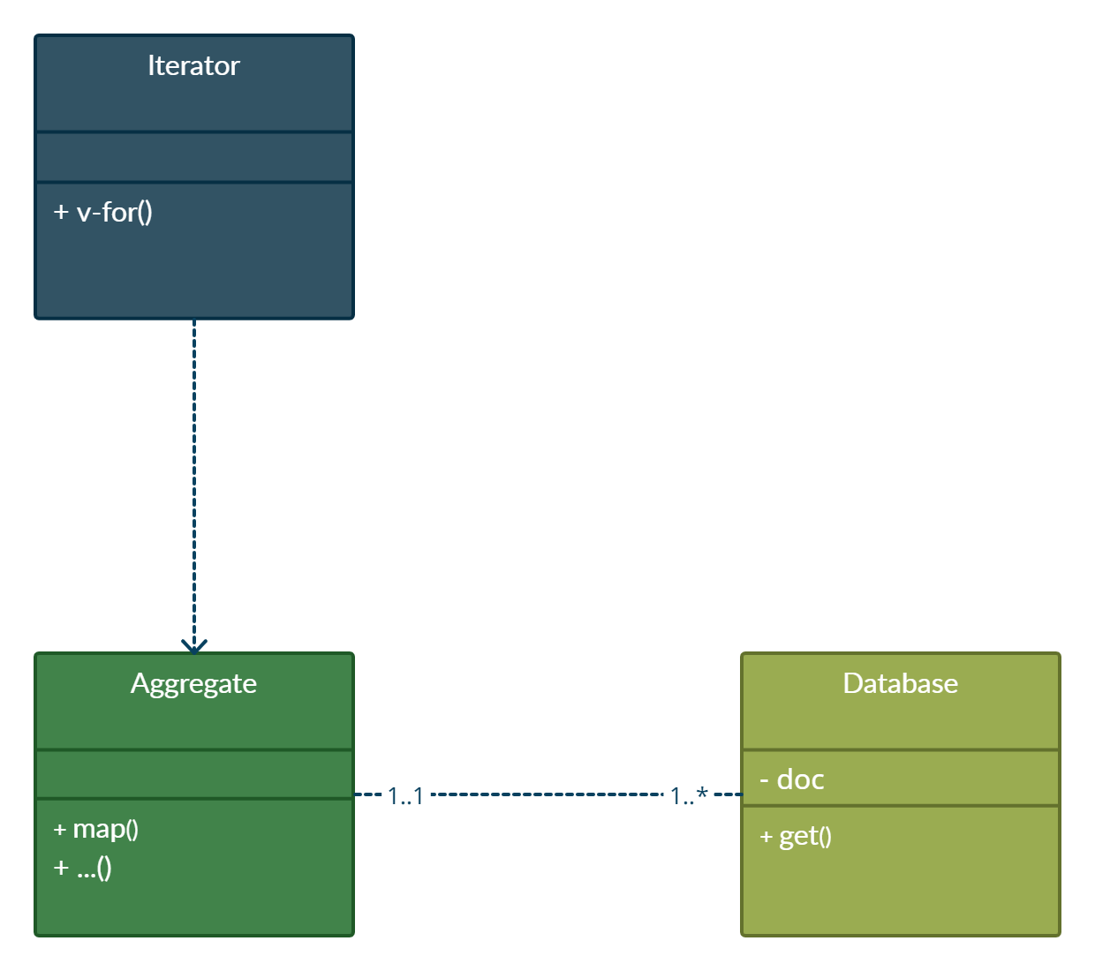
Design Pattern: Iterator Pattern

Slide 17
List of Software Development tools
Visual Studio Code
Javascript Framework: VueJS
Database: Firebase
Hosting: Firebase
Version control: Github

Slide 18
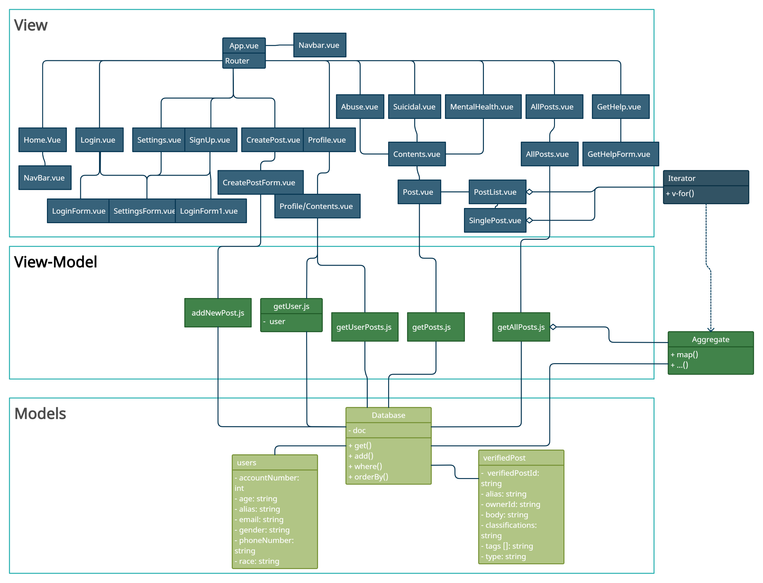
Class diagram incorporating design patterns

Slide 19
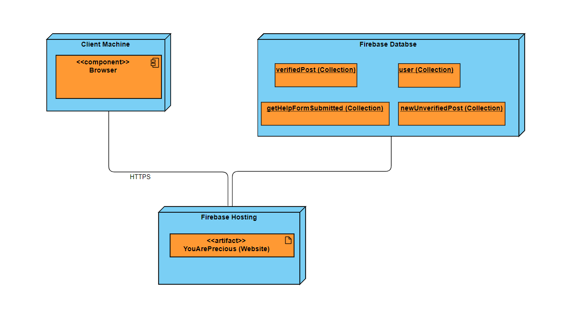
Deployment Diagram

Slide 20
Thank You
References:
https://www.raywenderlich.com/books/design-patterns-by-tutorials/v3.0/chapters/13-iterator-pattern
https://refactoring.guru/design-patterns/iterator
https://www.visual-paradigm.com/guide/uml-unified-modeling-language/uml-class-diagram-tutorial/
https://developer.mozilla.org/en-US/docs/Web/JavaScript/Reference/Statements/for...of
https://developer.mozilla.org/en-US/docs/Web/JavaScript/Reference/Global_Objects/Map
https://www.dofactory.com/javascript/design-patterns/iterator
https://www.oreilly.com/library/view/learning-javascript-design/9781449334840/ch12s05.html#:~:text=The%20Iterator%20is%20a%20design,to%20expose%20its%20underlying%20form.
https://www.tutorialspoint.com/design_pattern/iterator_pattern.htm
https://developer.mozilla.org/en-US/docs/Web/JavaScript/Reference/Global_Objects/Array/map
https://developer.mozilla.org/en-US/docs/Web/JavaScript/Reference/Operators/Spread_syntax
https://www.raywenderlich.com/34-design-patterns-by-tutorials-mvvm
https://012.vuejs.org/guide/

